Slide 1
Digital Portfolio
STUDENT NAME: DEVISREE R
REGISTER NO AND NMID: 212400992/
072AC8B5869BDCA98684B4165E617460
DEPARTMENT: COMPUTER APPLICATION
COLLEGE:COLLEGE/ UNIVERSITY PRINCE SHRI VENKATESWARA ARTS AND SCIENCE COLLEGE
MADRAS UNIVERSITY

Slide 2
PROJECT TITLE
DIGITAL
PORTFOLIO

Slide 3


AGENDA
Problem Statement
Project Overview
End Users
Tools and Technologies
Portfolio design and Layout
Features and Functionality
Results and Screenshots
Conclusion
Github Link
3/21/2024 Annual Review

Slide 4

PROBLEM STATEMENT Many students and aspiring developers lack a professional platform to showcase their skills and projects. Without a personal portfolio, it becomes challenging to present technical expertise and attract internship or job opportunities

Slide 5

PROJECT OVERVIEW This project is a personal digital portfolio website created using HTML, CSS, and possibly JavaScript. It highlights the student’s skills, academic background, and contact information in a clean and user-friendly manner.

Slide 6

WHO ARE THE END USERS? Primary Users: Recruiters, hiring managers, and potential clients who want to evaluate the student’s skills. Secondary Users: Teachers, peers, and mentors for academic or project review.

Slide 7

TOOLS AND TECHNIQUES HTML – For structure and layout of the website. CSS – For styling, colors, fonts, and layout design. JavaScript – For interactivity (if used for animations or navigation). React (Optional) – For dynamic UI components (if applied).

Slide 8
POTFOLIO DESIGN AND LAYOUT
Header: Contains the portfolio title and navigation menu (About, Skills, Contact). About Me Section: Short introduction about the student and career interests. Skills Section: Displays technical skills using neatly styled boxes.
8

Slide 9
FEATURES AND FUNCTIONALITY Responsive design for viewing on different devices. Simple navigation with sections linked via a menu bar. Visually appealing color scheme (blue and white with yellow highlights). Skills displayed in card-style boxes.

Slide 10
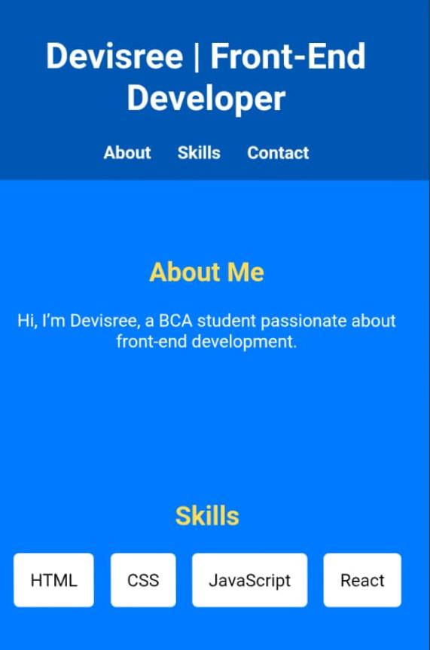

RESULTS AND SCREENSHOTS
3/21/2024 Annual Review
10

Slide 11
CONCLUSION The portfolio serves as a professional online resume that showcases technical skills, creativity, and personal branding. It can be expanded further with project showcases, certifications, and downloadable resumes.
11

Slide 12
GITHUB LINK
https://github.com/DEVI2007-prog/TNSDC-FWD-DP.git

